Slide 1
Basic Docker commands
Course Code: INT332

Slide 2
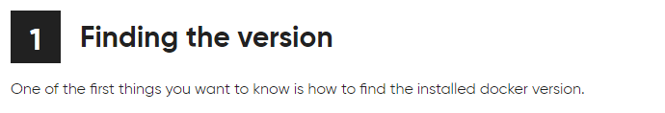
$ docker --version
Docker version 18.09.6, build 481bc77

Slide 3
2. Docker info
Get detailed information about docker installed on the system including the kernel version, number of containers and images, etc.
$ docker info
Containers: 3
Running: 1
Paused: 0
Stopped: 2
Images: 3
Server Version: 18.09.6
Storage Driver: overlay2
Backing Filesystem: extfs
Supports d_type: true Native Overlay Diff: true Logging Driver:

Slide 4
3. Checking History
.
Shows the history of a docker image with the image name mentioned in the command
$ docker history httpd
IMAGE CREATED CREATED BY SIZE COMMENT

Slide 5
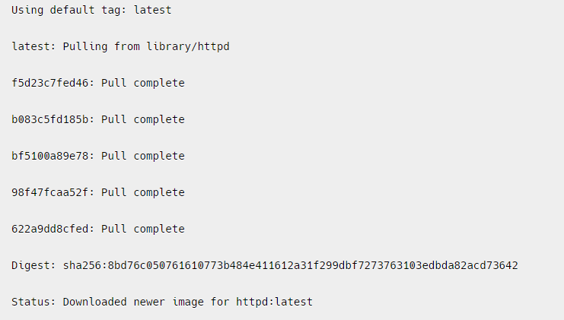
4 . Downloading Image
When we need to pull the docker image from dockerhub (docker repository) then ,the following example of pulling the the image and here we are taking Apache HTTP server image.
$ docker pull httpd

Slide 6
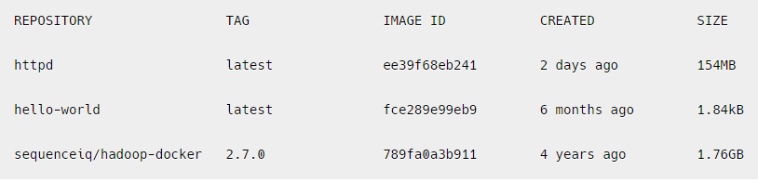
5. Images
To list all the docker images pulled on the system with image details such as TAG/IMAGE ID/SIZE etc.
$ docker images

Slide 7
6.RUN
The ‘docker run’ command is used to create and start a new container from a Docker image. The basic syntax of the ‘docker run’ command is as follows:
docker run [OPTIONS] IMAGE [COMMAND] [ARG…]
where,
OPTIONS: optional flags that configure the behaviour of the container, such as setting environment variables, mounting volumes, etc.
IMAGE: the name of the Docker image to be run.
COMMAND: the command to be executed when the container is started. If not provided, the default command specified in the Docker image will be used.
ARG: optional arguments passed to the command.
-d means

Slide 8
Options Available for executing Docker Run Command
Some commonly used options for executing the docker run command inside a container:
-it: Runs the container in interactive mode, allowing you to interact with the container through the command line.
-d: Runs the container in the background.
-- name: Specifies a name for the container.
-- rm: Automatically removes the container when it exits.
-p: Maps a host port to a container port.
-e / --env: Sets an environment variable inside the container.
-v: Mounts a host volume inside the container.

Slide 9
1st Example : Running a Simple Image:
docker run httpd echo “Hello, World!”
This command runs a new container from the ‘httpd ’ image and executes the ‘echo’ command with the argument “Hello, World!”.

Slide 10
2nd example
Running a Container with a Specific Name:
$ docker run --name my-container httpd echo “Hello, World!”
--name : this option is to give the name of container
my-container: it is the name of container
Echo: it is the command
“hello,world!” – it is argument used
This command runs a new container with the specified name “my-container” from the httpd image and executes the echo command with the argument “Hello, World!”.

Slide 11
What are Environment Variables
Environment variables are key–value pairs used by applications to:
Read configuration
Store secrets (usernames, passwords)
Control application behavior without changing the image
Environment variables allow us to configure containers dynamically.

Slide 12
Need of environment variables in Docker
Without -e:
Configuration must be hard-coded in the image
Need to rebuild image for every change
With -e:
Same image → different behavior
Secure & flexible configuration
Widely used in microservices & cloud deployments

Slide 13
3rd Example : Setting Environment:
docker run -e MY_VAR=value httpd env
This command sets an environment variable ‘MY_VAR’ to the value “value” and runs a new container from the ‘httpd’ image.
The ‘env’ command is executed to display the list of environment variables in the container.

Slide 14
MY_NAME is created inside the container
Host system is not affected
MY_NAME is created inside the container
Host system is not affected
MY_NAME is created inside the container
Host system is not affected
2nd Example: Run a container from Image and display the variable name inside it.
docker run -it -e MY_NAME=Harpreet ubuntu bash
It will open the container and you can check the env variable inside it as:
Echo $ MY_NAME
Kindly note :
MY_NAME is created inside the container
Host system is not affected

Slide 15
Multiple Environment Variables
docker run -e APP_ENV=production -e APP_VERSION=1.0 nginx
Same for MySQL Container
docker run -d \
-e MYSQL_ROOT_PASSWORD=root123 \
-e MYSQL_DATABASE=college \
-e MYSQL_USER=admin \
-e MYSQL_PASSWORD=admin123 \
mysql:8
Without these variables, MySQL container will fail to start
Notes:
Env=development then Debugging, logs, or mock data could be enabled here.
Open http://localhost:8080 → Shows Environment: production. Optimizations, caching, and security features can be enabled automatically.

Slide 16
Next is : Passing Environment Variable from Host System
Ex#1:
Step 1: Set variable on host
export APP_PORT=8080 (Ubuntu)
Powershell - $env:APP_PORT=8080
Check host variable - echo $env:APP_PORT
Step 2:
docker run -e APP_PORT=$env:APP_PORT nginx env
docker run -e APP_PORT=$APP_PORT nginx env
Notes:
docker run -d -p 8080:80 -e APP_ENV=$APP_ENV nginx
$APP_ENV is read from your host environment.
-e APP_PORT=$APP_PORT: Pass the environment variable APP_PORT from your host system into the container.

Slide 17
Another way : Using --env-file (Clean & Professional Way)
Create .env file
DB_HOST=localhost
DB_USER=root
DB_PASS=secret
Then Run container
docker run --env-file .env myapp

Slide 18
4th Example
$ docker run -it -d httpd
Here :
-it flag enables interactive mode, so you can interact with the container’s command line
The -d flag runs the container in the background and the httpd argument specifies the image name to use for the container. This command will pull the httpd image from Docker Hub if it is not already present on your local machine, create a container based on that image, and start it in the background.

Slide 19
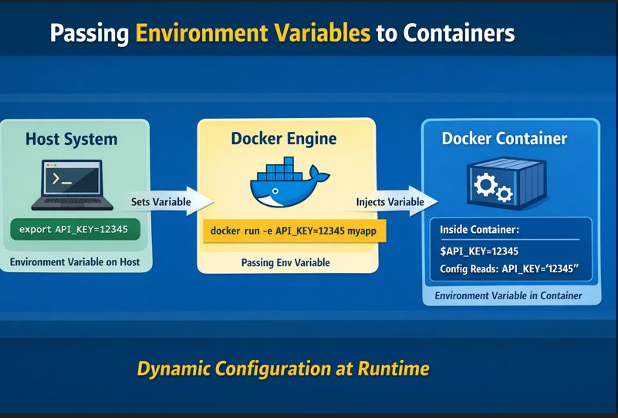

Slide 20
-p optional flag in run command
-p stands for publish port.
It maps a port on your host machine to a port inside the container.
In simple words:
-p allows users outside the container to access an application running inside the container.
By default:
Containers run in an isolated network
Applications inside containers are NOT accessible from the host/browser
So if a web server is running inside a container, you must expose it using -p.

Slide 21
Syntax of –p
docker run -p <HOST_PORT>:<CONTAINER_PORT> IMAGE
Part | Description
HOST_PORT | Port on your system (Laptop/Server)
CONTAINER_PORT | Port where app runs inside container

Slide 22
EX#1:
Without –p
docker run nginx
As no port mapping done here
Try opening browser: But it is Not accessible

Slide 23
Now try to Run Nginx with -p
docker run -p 8080:80 nginx
What happens internally?
Browser → localhost:8080 → Docker Host → Container:80 → Nginx

Slide 24
docker run -d -p 3307:3306 --name mysql-test –e MYSQL_ROOT_PASSWORD=root123 mysql
docker exec -it mysql-test bash
mysql -h 127.0.0.1 -P 3306 -u root –p

Slide 25
7 What’s running?
To lists all the docker containers are running with container details.
.
$ docker ps

Slide 26
TASK #1:
Run Ubuntu container
Pass -e COLLEGE=CSE
Show echo $COLLEGE
Stop container → variable disappears
Run Ubuntu container
Pass -e COLLEGE=CSE
Show echo $COLLEGE
Stop container then check what happened

Slide 27
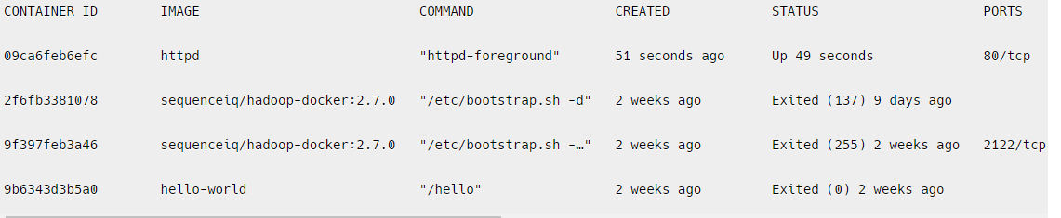
8. ps -a
To list all the docker containers running/exited/stopped with container details
$ docker ps -a

Slide 28
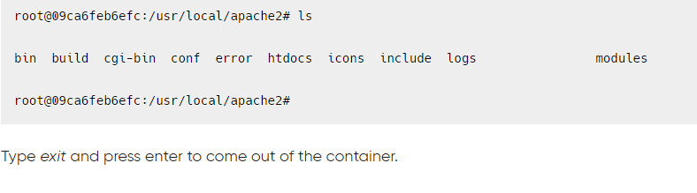
9. exec
Access the docker container and run commands inside the container in bash
$ docker exec -it 09ca6feb6efc bash/env
09ca6feb6efc --- it is Id of the container

Slide 29
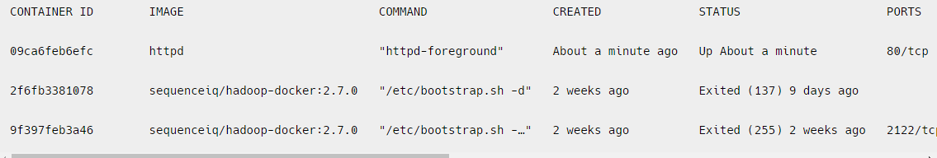
10. Removing container
Remove the docker container with container id mentioned in the command.
$ docker rm 9b6343d3b5a0
Run the below command to check if the container got removed or not.
$ docker ps -a

Slide 30
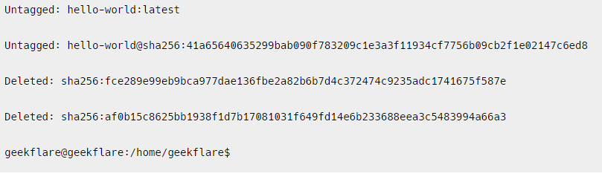
11. Removing image
Remove the docker image with the docker image id mentioned in the command
$ docker rmi fce289e99eb9

Slide 31
..contd..
To remove the image forcefully
$ docker rmi –f <image id>
docker rmi -f 92fa43a2ff60503fdf250
Untagged: httpd:latest
Untagged: httpd@sha256:7765977cf2063fec486b63ddea574faf8fbed285f2b17020fa7ef70a4926cdec
Deleted: sha256:92fa43a2ff60503fdf250ef0a16d4170aa2a47c4b5a60d427724283543a8792a

Slide 32
Practice Questions on Basic Docker Commands
Run a Docker container based on the nginx image, exposing port 8080 on the host to port 80 on the container. Set an environment variable NGINX_PORT=8080 inside the container and start the container interactively.
Run a Docker container named “DB-app" based on the “mongodb" image, and expose port 80 on the host to port 8082 on the container?
docker pull mongo
docker run -d --name DB-app -p 80:8082 mongo
Run a Docker container based on the nginx image, exposing port 8080 on the host to port 80 on the container. Set an environment variable NGINX_PORT=8080 inside the container and start the container interactively.

Slide 33
You are a DevOps engineer in a startup company. The development team asks you to quickly deploy a simple web page that displays the message:
Use the official httpd Docker image.
Run the container so it is accessible on port 8080 of the host machine.
Create or update an HTML file inside the container to display the required message.
Verify the output using a command-line tool.
Properly stop and remove the container after testing.

Slide 34
docker pull httpd
docker run -d --name my-apache -p 8080:80 httpd
docker exec -it my-apache bash -c "echo '<h1>Hello from Docker Apache!</h1>' > /usr/local/apache2/htdocs/index.html"
curl http://localhost:8080
docker stop my-apache
docker rm my-apache

Slide 35
3. How would you use the docker run command with -it, -e, -v, and --name to:
• Set an environment variable APP_ENV=production.
• Bind a local directory /app/data to /data inside the container.
• Name the container my_app.

Slide 36
docker pull ubuntu
mkdir C:\app\data
docker run -it --name my_app -e APP_ENV=production -v C:\app\data:/data ubuntu /bin/bash
echo $APP_ENV
echo "Hello this is my first program" > /data/test.txt
cat /data/test.txt
echo "Second line added" >> /data/test.txt
cat /data/test.txt
exit

Slide 37
Docker container commands:
1. Container Lifecycle Management
Run a container (creates and starts it)
docker run -d -p 80:80 --name my_container nginx
Start a stopped container
docker start <container_id/name>
Stop a running container
docker stop <container_id/name>
Restart a container
docker restart <container_id/name>
Pause a container
docker pause <container_id/name>

Slide 38
…contd….
Unpause a paused container
docker unpause <container_id/name>
Kill a container (force stop)
docker kill <container_id/name>
Remove a container
docker rm <container_id/name>
Remove all stopped containers
docker container prune

Slide 39
2. Listing and Inspecting Containers
List all running containers
docker ps
List all containers (including stopped ones)
docker ps -a
Show detailed info about a container
docker inspect <container_id/name>
Display resource usage stats of a container
docker stats <container_id/name>
View container logs
docker logs <container_id/name>
Follow logs in real-time
docker logs -f <container_id/name>

Slide 40
3. Container Interaction with Host
Execute a command inside a running container
docker exec -it <container_id/name> <command>
Attach to a running container's interactive shell
docker attach <container_id/name>
Copy files between container and host
  From container to host:
  docker cp <container_id>:<container_path> <host_path>
  From host to container:
  docker cp <host_path> <container_id>:<container_path>
E.g:

Slide 41
Commands for CI with Host
docker exec -it Container ID ls /
docker exec -it Container ID /bin/bash
mkdir /data
echo "Hello Docker" > /data/test.txt
exit
docker attach Container ID
docker cp Container ID:/data/test.txt C:\Users\HP\Desktop\
docker cp C:\Users\HP\Desktop\test.txt Container ID :/data/sample.txt
docker exec -it Container ID ls /data
docker exec -it Container ID cat /data/sample.txt

Slide 42
Task
Inside this same running container, you are required to:
Create a new directory named /project.
Inside /project, create a file called report.txt.
Add the following text inside the file:
This is our container interaction with our host machine.
Verify the file content.
Copy report.txt from the container to your Desktop.
Create another file named notes.txt in the same /project directory.
Append the text:
Verify that both files exist inside /project.

Slide 43
docker exec -it 63de1b6c3391d6a4687e00e375ca9cfe4685e959c2b774deb8f99187beaf3224 mkdir /project
docker exec -it 63de1b6c3391d6a4687e00e375ca9cfe4685e959c2b774deb8f99187beaf3224 sh -c "echo 'Docker Lab Assignment' > /project/report.txt"
docker exec -it 63de1b6c3391d6a4687e00e375ca9cfe4685e959c2b774deb8f99187beaf3224 sh -c "echo 'Container File Creation Test' >> /project/report.txt"
docker exec -it 63de1b6c3391d6a4687e00e375ca9cfe4685e959c2b774deb8f99187beaf3224 cat /project/report.txt

Slide 44
docker cp 63de1b6c3391d6a4687e00e375ca9cfe4685e959c2b774deb8f99187beaf3224:/project/report.txt C:\Users\HP\Desktop\
docker exec -it 63de1b6c3391d6a4687e00e375ca9cfe4685e959c2b774deb8f99187beaf3224 sh -c "echo 'This is an additional file inside the same container.' > /project/notes.txt"
docker exec -it 63de1b6c3391d6a4687e00e375ca9cfe4685e959c2b774deb8f99187beaf3224 ls /project
docker exec -it 63de1b6c3391d6a4687e00e375ca9cfe4685e959c2b774deb8f99187beaf3224 cat /project/notes.txt

Slide 45
Practice questions:
1. You need to start a new container using the nginx image while setting an environment variable ENV_MODE=production. Write the docker run command to achieve this.
2. You have a running container named my_app, but it's not behaving as expected. You want to check its logs to debug any errors. Write the command to view its logs and follow new log entries in real-time.
3. A container named web_server was stopped. Write the command to:a) Start the container again.b) Stop the container when needed.

Slide 46
Work on Volumes
Basic commands used to create,inpect,verify , delete/remove the volumes
docker volume create <volume name>
docker volume ls
docker volume inspect mydata
docker run -d -v <volumename>:<path where to store in image> --name <containername> <imagename>

Slide 47
docker volume create mydata
docker volume ls
docker volume inspect mydata
docker run -dit --name mycontainer -v mydata:/app/data ubuntu
docker exec -it mycontainer ls /app/data
docker inspect mycontainer
docker rm -f mycontainer
docker volume rm mydata
docker volume prune

Slide 48
Create a Docker volume named projectdata.
Verify that the volume has been created successfully.
Inspect the volume and identify:The mount point (where Docker stores it on the host system).
Run an Ubuntu container in detached mode:
Name the container project_container.
Attach the volume projectdata inside the container at /app/data.
Inside the running container:Create a file named report.txt inside /app/data.
Add the text: This is my first volume.
Stop and remove the container.
Run a new Ubuntu container:Name it project_container_new.
Attach the same volume projectdata at /app/data.
Verify that report.txt still exists and contains the same data.

Slide 49
docker volume create projectdata
docker volume ls
docker volume inspect projectdata
docker run -dit --name project_container -v projectdata:/app/data ubuntu
docker exec -it project_container sh -c "echo This is my first volume' > /app/data/report.txt“
docker exec -it project_container cat /app/data/report.txt
docker stop project_container
docker rm project_container
docker run -dit --name project_container_new -v projectdata:/app/data ubuntu
docker exec -it project_container_new ls /app/data
docker exec -it project_container_new cat /app/data/report.txt

Slide 50
Task 1
You are a DevOps engineer at a university. The web development team has built a simple HTML-based portal and wants it deployed using Docker.
Use the official httpd image.
Name the container college_portal.
Run it in detached mode.
Expose container port 80 to host port 8080.
Set environment variable ENV=production.
Attach a Docker volume named portaldata to store website files.
Modify the index.html file inside the container.
Verify the output in the browser.
Check logs if the page is not loading.
Stop and remove the container.
Remove the volume and image after testing.

Slide 51
docker pull httpd
docker volume create portaldata
docker run -dit --name college_portal -p 8080:80 -e ENV=production -v portaldata:/usr/local/apache2/htdocs httpd
docker exec -it college_portal bash -c "echo '<h1>Welcome to University Portal - Production Mode</h1>' > /usr/local/apache2/htdocs/index.html“
curl http://localhost:8080
docker logs college_portal
docker logs -f college_portal
docker stop college_portal
docker rm college_portal
docker volume rm portaldata
docker rmi httpd

Slide 52
Task 2
Your backend team reports that their MySQL container is failing to start.
Use mysql:8 image.
Set required environment variables:
  MYSQL_ROOT_PASSWORD
  MYSQL_DATABASE
  MYSQL_USER
  MYSQL_PASSWORD
Run in background.
Expose port 3306 to host port 3307.
Check logs to identify errors.
Enter inside container to verify database.
Stop and remove container after debugging.

Slide 53
docker pull mysql:8
docker run -d --name mysql_debug -p 3307:3306 -e MYSQL_ROOT_PASSWORD=root123 -e MYSQL_DATABASE=college -e MYSQL_USER=admin -e MYSQL_PASSWORD=admin123 mysql:8
docker ps
docker logs mysql_debug
docker logs -f mysql_debug
docker exec -it mysql_debug bash
mysql -u root –p // # (Enter password: root123)
exit
Exit
docker stop mysql_debug
docker rm mysql_debug

Slide 54
Image creation in detail

Slide 55
mkdir nginx-app
cd nginx-app
notepad index.html

Slide 56
<!DOCTYPE html>
<html>
<head>
<title>Medium Level Docker App</title>
</head>
<body>
<h1>Welcome to My Custom Docker Nginx App</h1>
<p>This is a medium-level Docker project.</p>
</body>
</html>

Slide 57
notepad default.conf
server {
listen 80;
server_name localhost;
location / {
root /usr/share/nginx/html;
index index.html;
}
}

Slide 58
notepad Dockerfile
FROM nginx:alpine
COPY index.html /usr/share/nginx/html/index.html
COPY default.conf /etc/nginx/conf.d/default.conf
EXPOSE 80

Slide 59
Dir
docker build -t custom-nginx:v1 .
docker run -d -p 8080:80 --name nginx-container custom-nginx:v1
http://localhost:8080

Slide 60
mkdir node-app
cd node-app
apt update
apt install nano -y

Slide 61
Create app.js
const express = require("express");
const app = express();
app.get("/", (req, res) => {
res.send("Docker Node App Running!");
});
app.listen(3000, "0.0.0.0", () => {
console.log("Server running on port 3000");
});

Slide 62
Create package.json
{
"name": "node-docker-app",
"version": "1.0.0",
"main": "app.js",
"dependencies": {
"express": "^4.18.2"
}
}

Slide 63
Create Dockerfile
FROM node:18-alpine
WORKDIR /app
COPY package.json .
RUN npm install
COPY app.js .
EXPOSE 3000
CMD ["node", "app.js"]

Slide 64
Verify files
Dir
app.js
package.json
Dockerfile- Rename-Item Dockerfile.txt Dockerfile

Slide 65
Build & run & verify
docker build -t node-demo:v1 .
Docker run -d -p 3000:3000 --name node-container node-demo:v1
docker ps
OPEN BROWSER
http://localhost:3000
Docker Node App Running!

Slide 66
Docker Networking
Docker provides different network drivers to control how containers communicate.
A. Bridge Network (Default)
Default network when you run a container.
Containers on same bridge can communicate via IP.
Best for standalone containers on single host.

Slide 67
# List networks
docker network ls
# Inspect bridge network
docker network inspect bridge
# Create custom bridge network
docker network create my_bridge_net
# Run container in custom bridge
docker run -d --name container1 --network my_bridge_net nginx
docker run -d --name container2 --network my_bridge_net alpine sleep 300
# Test communication
docker exec -it container2 ping container1

Slide 68
B. Host Network
Container shares host’s networking stack.
No separate IP.
Faster performance.
Linux only.
docker run -d --network host nginx
curl http://localhost

Slide 69
C. Overlay Network
Used in Docker Swarm.
Connects containers across multiple hosts.
# Initialize swarm
docker swarm init
# Create overlay network
docker network create -d overlay my_overlay
# Deploy service using overlay
docker service create --name web --network my_overlay -p 8080:80 nginx

Slide 70
DNS Inside Docker
Docker has built-in DNS.
Containers resolve each other by container name (if same custom network).
Works only in user-defined bridge networks.

Slide 71
docker network create app_net
docker run -d --name backend --network app_net nginx
docker run -it --name client --network app_net alpine sh
ping backend

Slide 72
Linking Containers (Legacy)
Before custom networks, Docker used --link.
Deprecated method. Use networks instead.
docker run -d --name db nginx
docker run -it --name app --link db:database alpine sh

Slide 73
# Create volume
docker volume create my_volume
# List volumes
docker volume ls
# Run container with volume
docker run -d \
--name my_nginx \
-v my_volume:/usr/share/nginx/html \
nginx

Slide 74
docker volume inspect my_volume
docker volume rm my_volume

Slide 75
Bind Mounts
Mounts host directory into container
Useful for development
docker run -d \
-v $(pwd)/html:/usr/share/nginx/html \
-p 8080:80 \
nginx

Slide 76
Volume Vs Bind Mount
Feature | Volume | Bind Mount
Managed by Docker | ✅ | ❌
Best for production | ✅ | ⚠️
Host path dependency | ❌ | ✅
Performance | Good | Good

Slide 77
Complete Example
docker network create app_bridge
docker network ls
docker volume create mysql_data
docker volume inspect mysql_data
docker run -d --name mysql_db --network app_bridge -e MYSQL_ROOT_PASSWORD=root -e MYSQL_DATABASE=myapp -v mysql_data:/var/lib/mysql mysql:8
docker run -d --name backend_app --network app_bridge -e DB_HOST=mysql_db node:18-alpine sh -c "apk add curl && sleep 300"

Slide 78
docker exec -it backend_app ping mysql_db
docker run -d --name frontend --network app_bridge -p 8080:80 nginx

